Slide 1
Types of Frogs; Extinct/Threatened, Tree Frogs, True Frogs, Poisonous Frogs
Kylie Mazurkiewicz, ©2015
Third Grade, Science
Life Cycle
June 11th, 2015

Slide 2
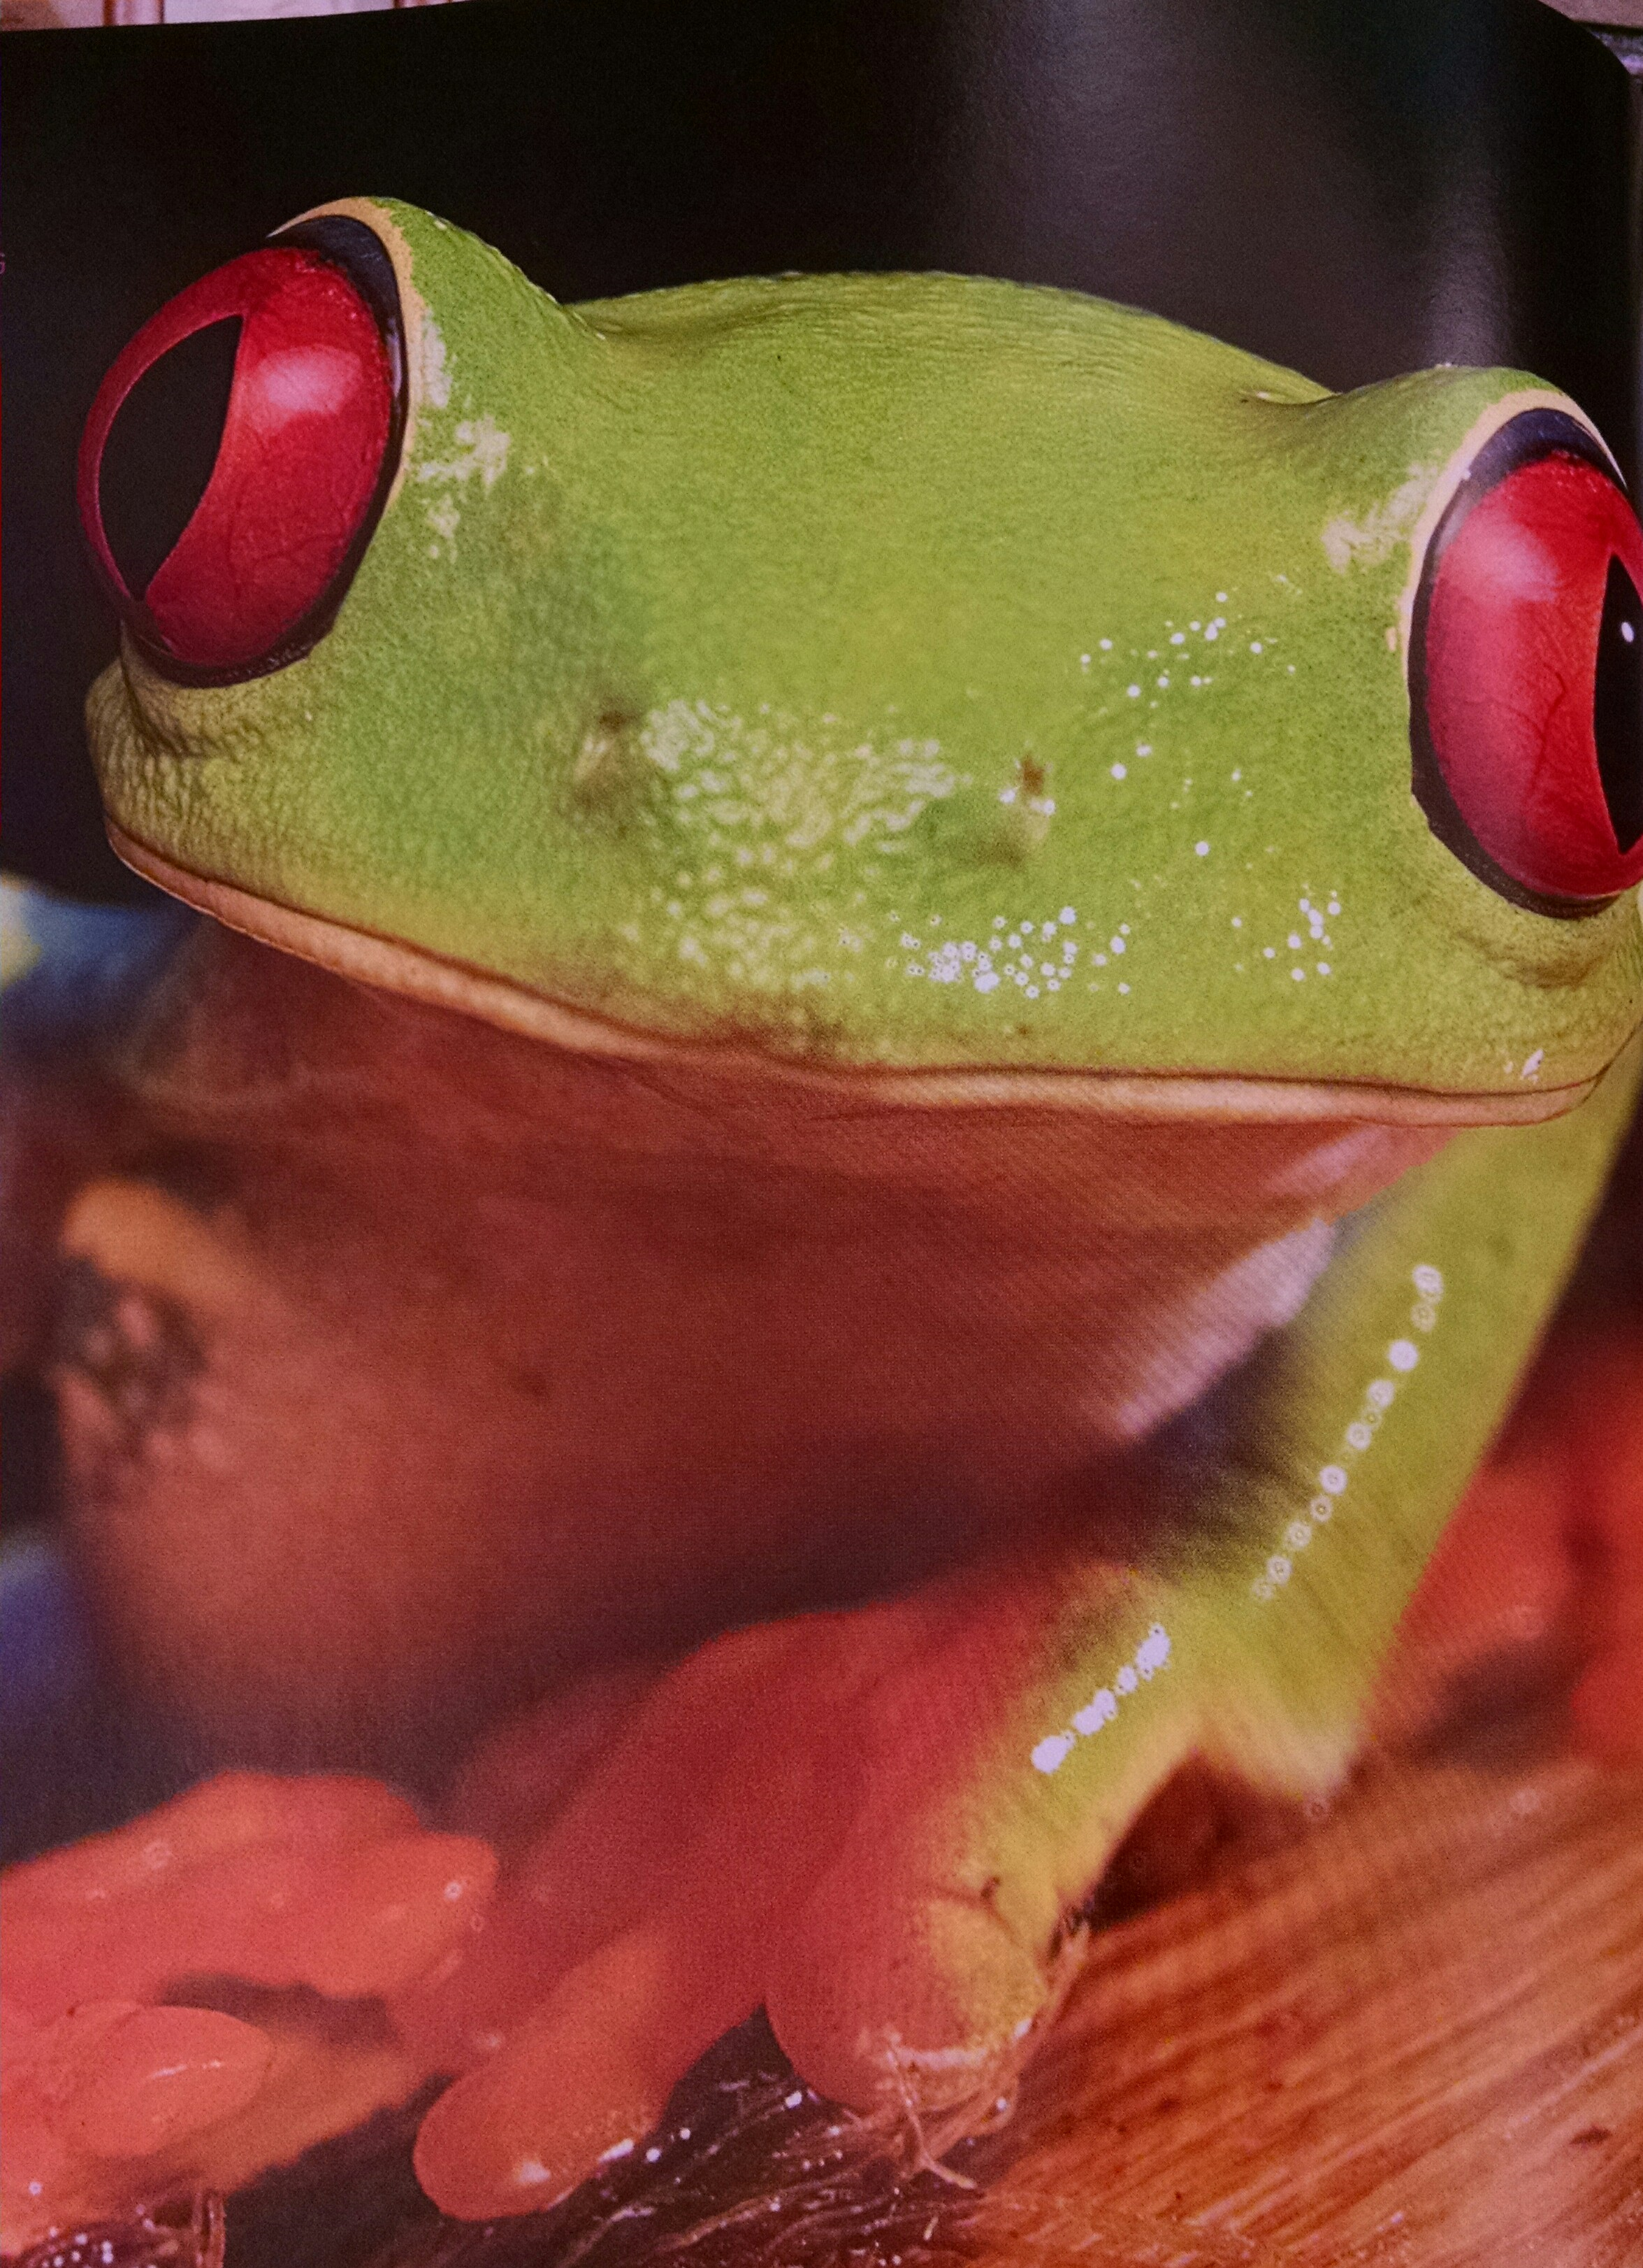
My Frog Booklet
Click on the photo to print the frog booklet. Please color the first page in the frog booklet. After coloring the first page of your book, write something you already know about frogs. Then write something you want to learn about frogs. Leave the last page blank.
Bring completed work to class by Wednesday, June 17th.
Photo from The Frog Scientist book

Slide 3
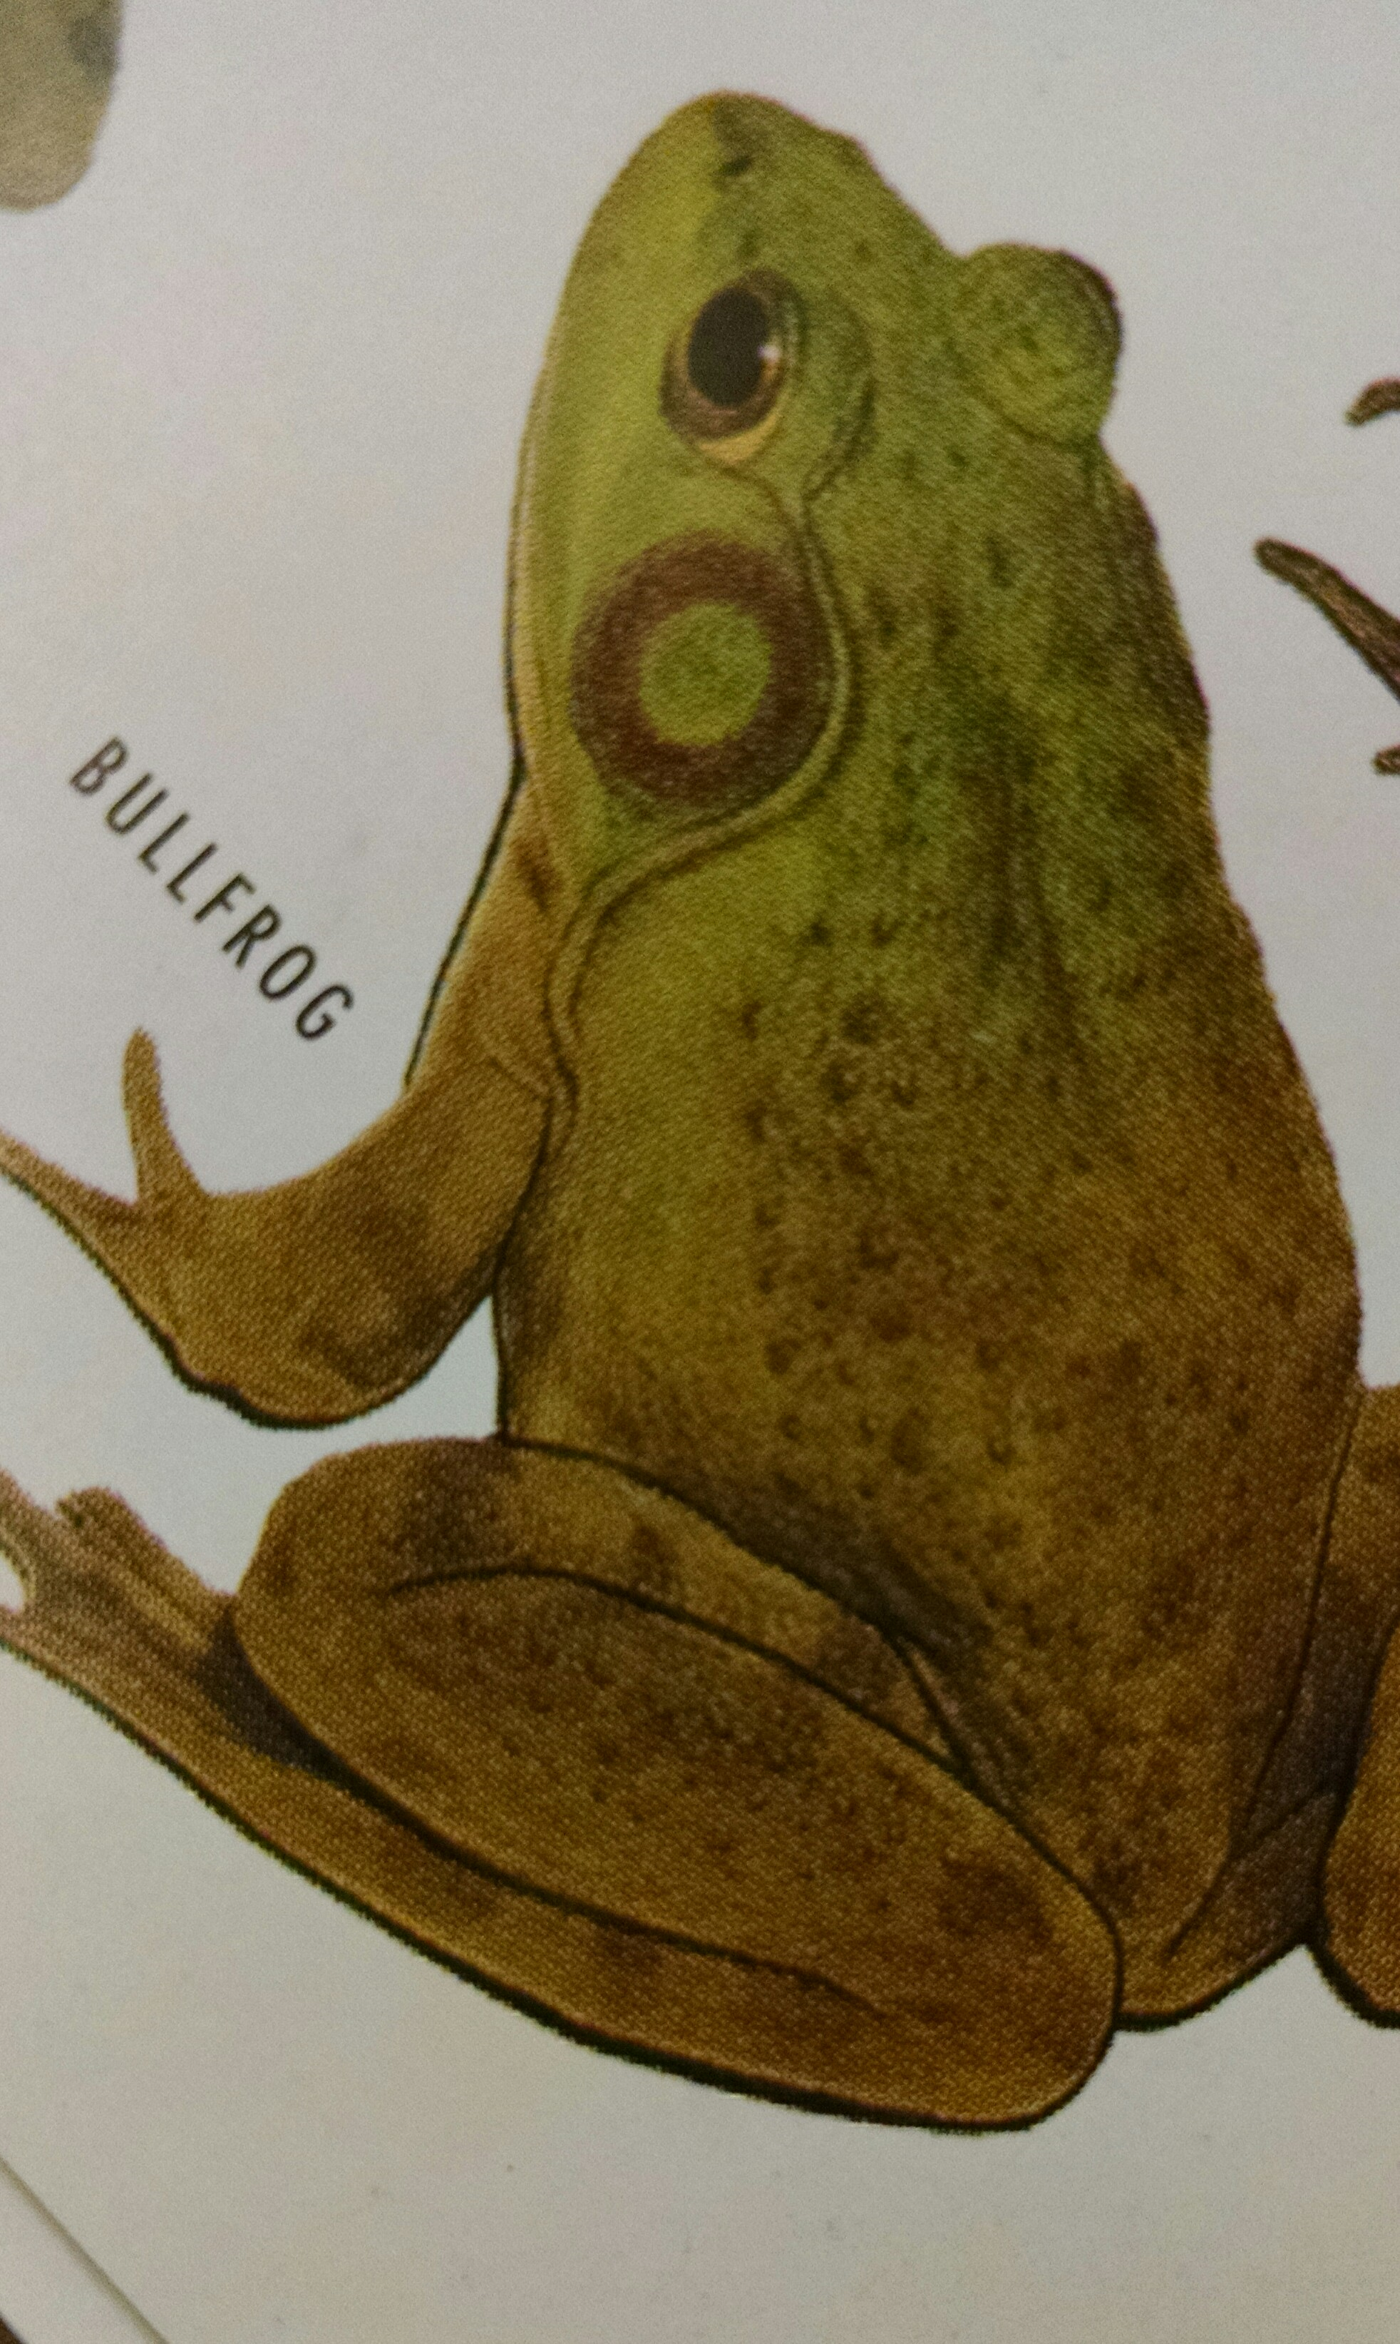
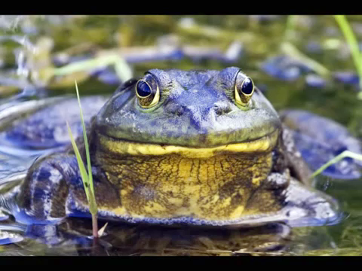
Bull Frog (Largest True Frog)
Can be green or grey/brown in color
Prefers larger bodies of water (lakes, swamps, streams, and ponds)
Eats mostly anything that moves, and that it can fit in its mouth (water snakes)
Found in many areas, mostly the western states
Hind feet are webbed, and the fourth toe extends beyond the web
Photo from Frogs: A Wildlife Handbook

Slide 4
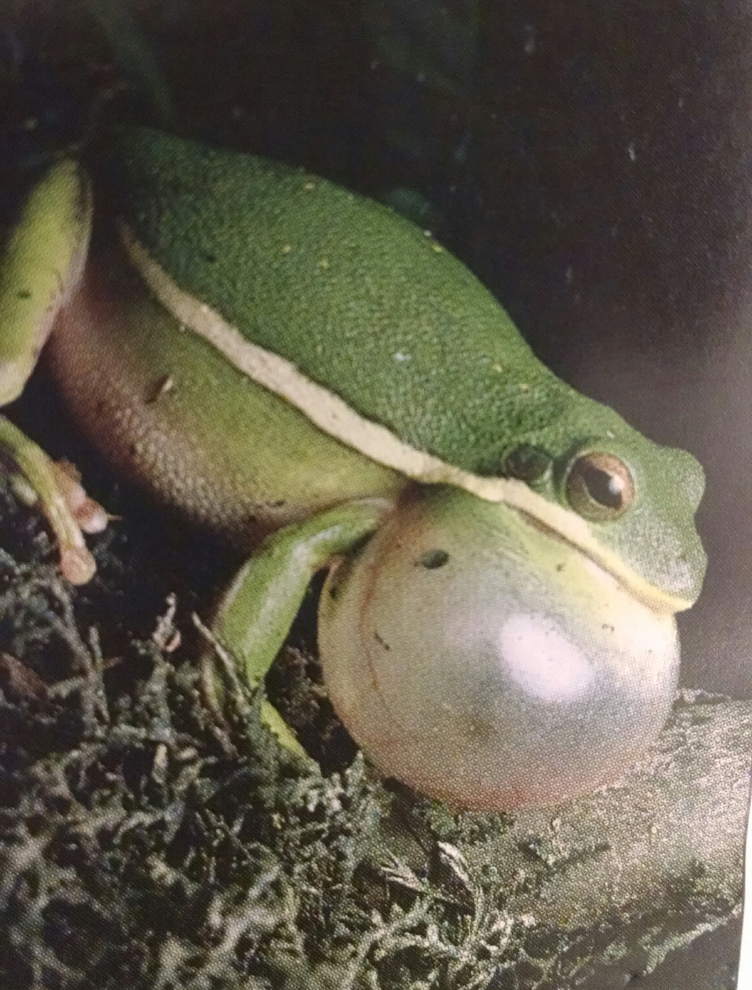
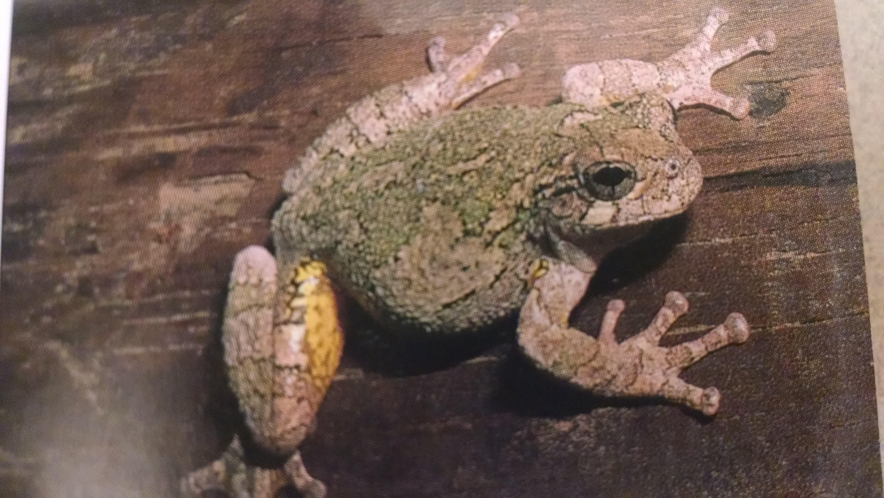
Tree Frogs
Photos from Reptiles and Amphibians book
GREEN TREE FROG GRAY TREE FROG
Usually bright green or yellow in color Gray or green in color
Sings (call) during damp weather Skin of back is warty
Lives near dampness (swamps, boarders Not often seen on ground or
of lakes) at waters edge
Visits windows near night, attracted to Seen in shrubs or trees
insects by lights Camouflaged to bark
Located in the south and west Lives in North America

Slide 5
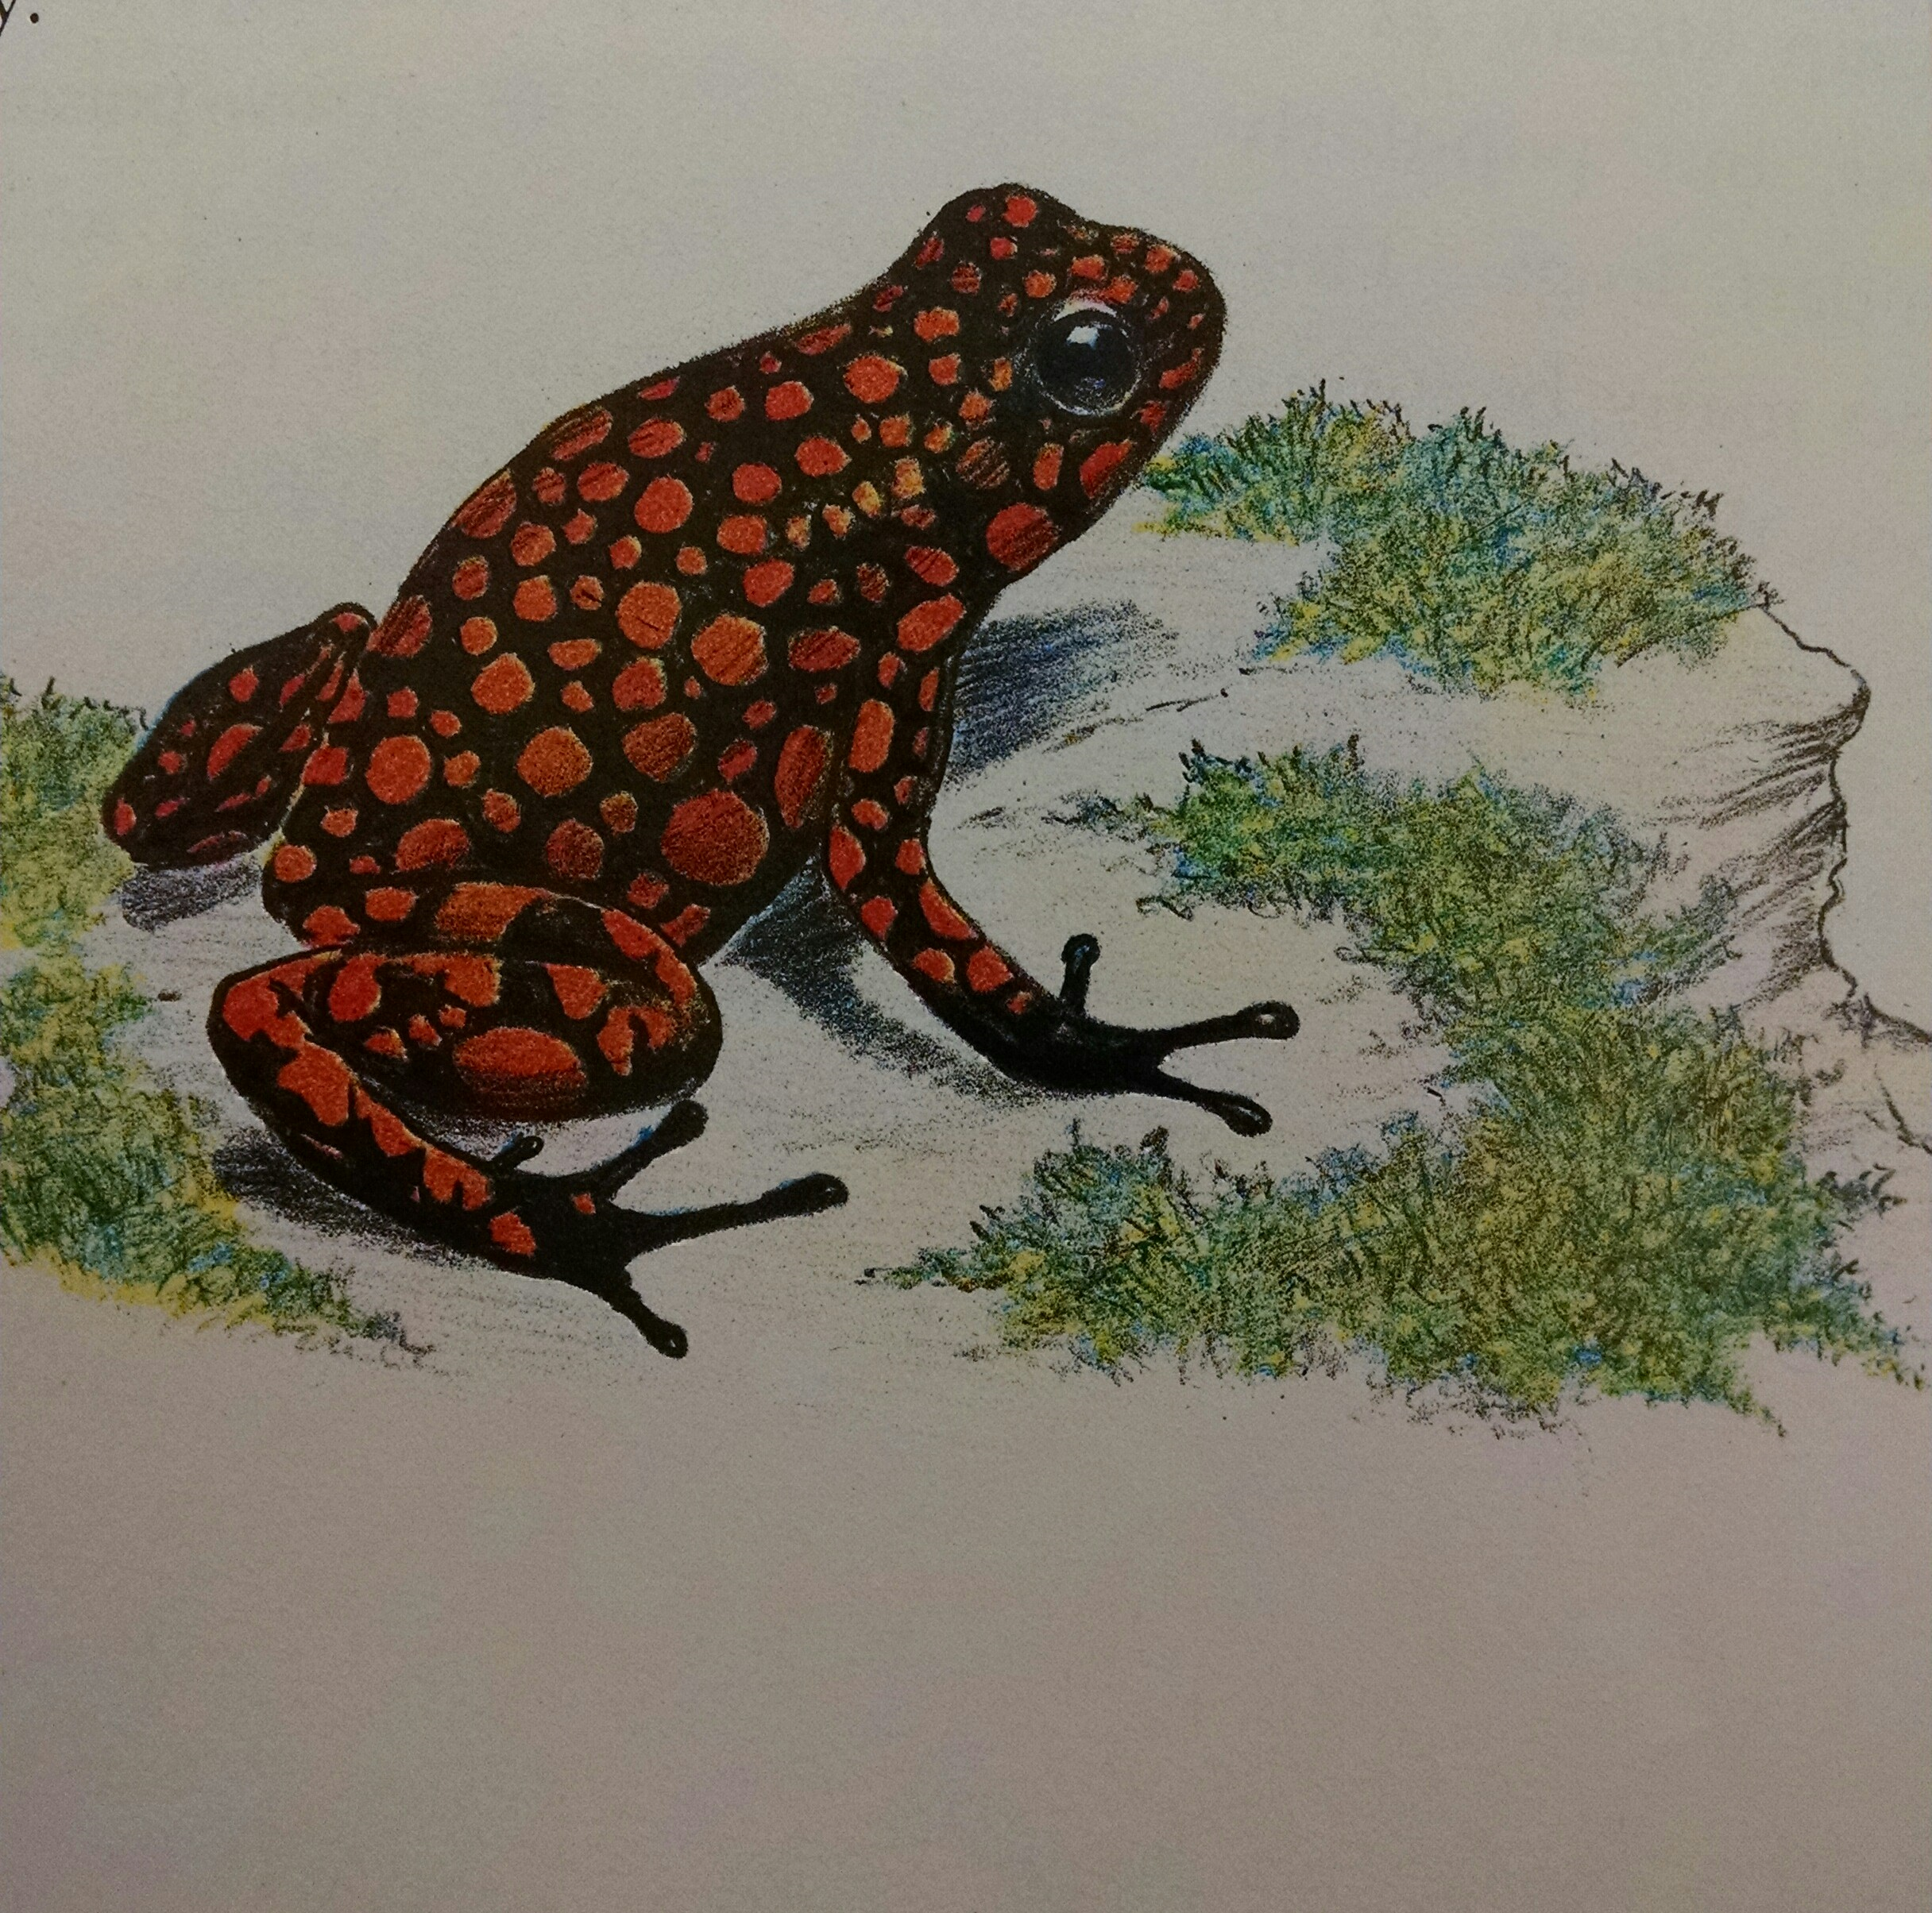
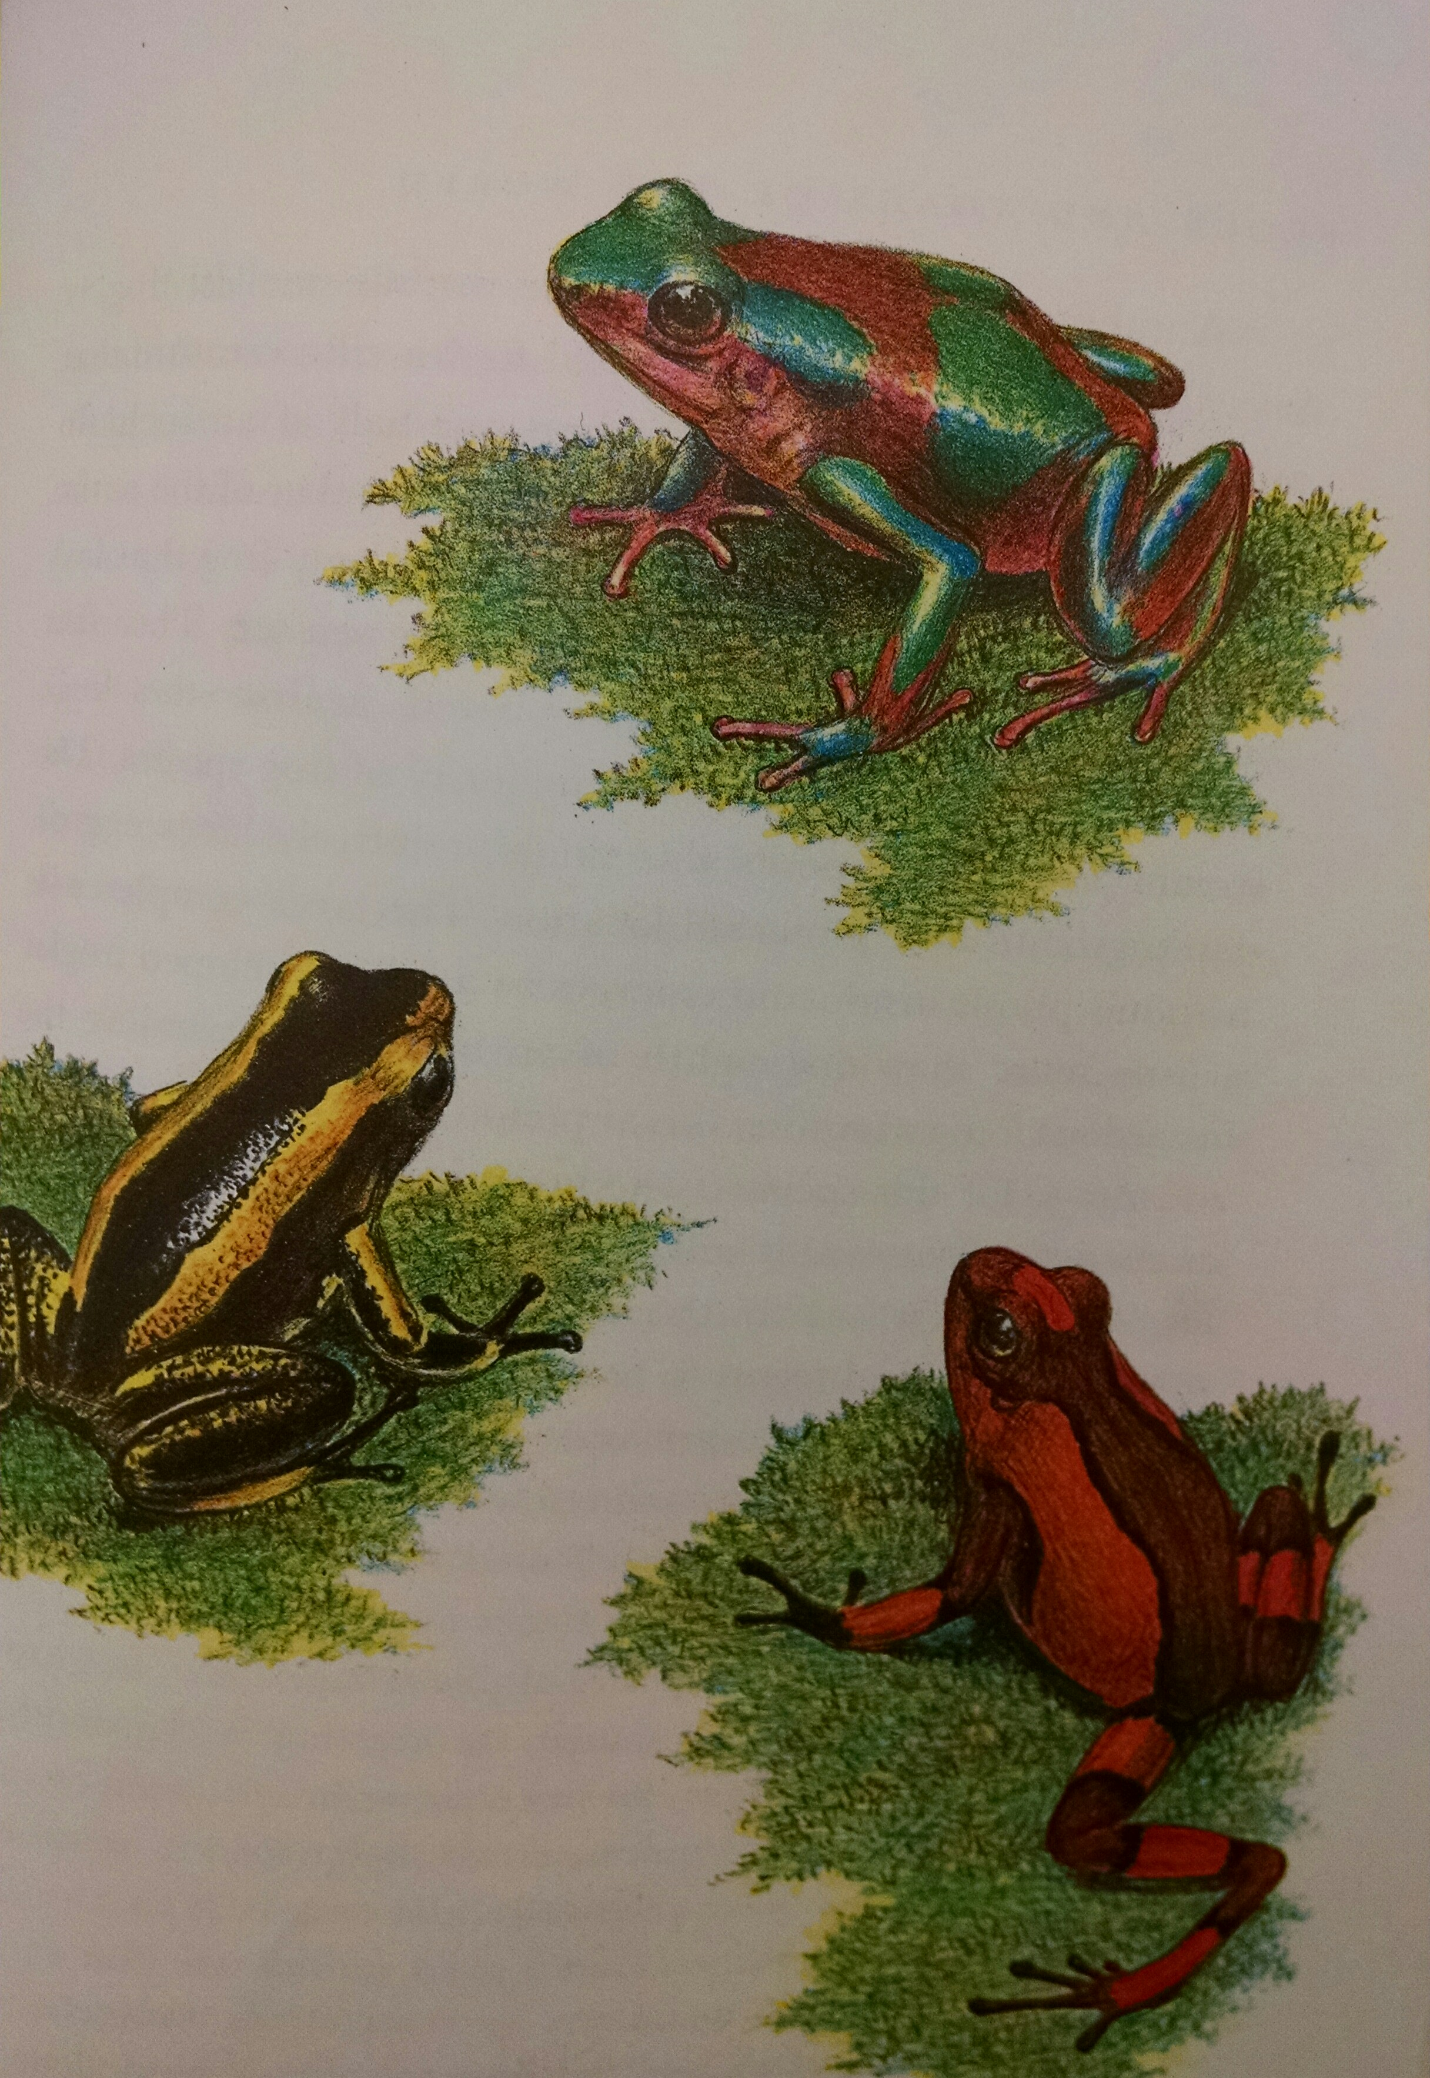
Poisonous Frogs
Photos from Frogs and Toads of the world book
Poison Arrow Frogs
Located in Central and South America
Bright colors (red and yellow)
Produce poison that is deadly to predators
Poisonous from what they eat
Lives on soggy ground and within roots in the rain forest

Slide 6
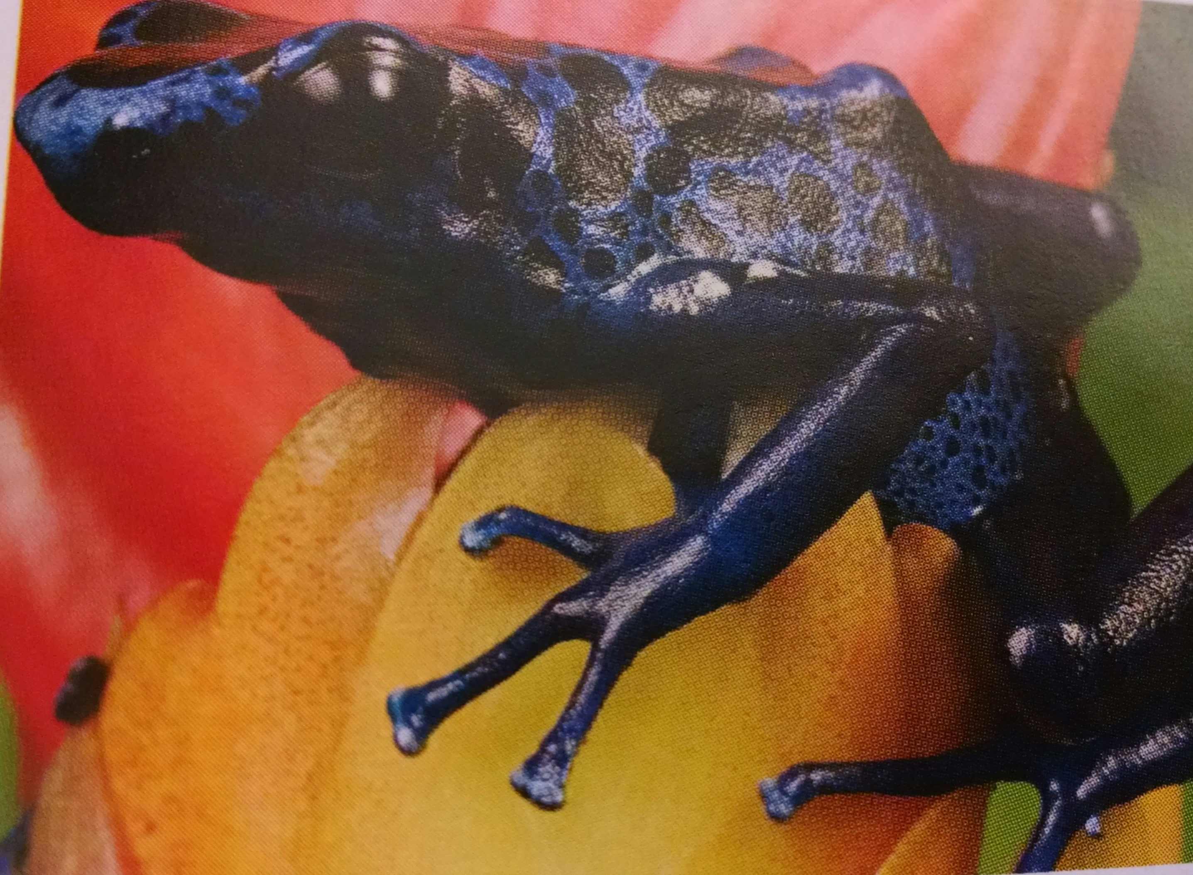
Blue Poison Dart Frog
Lives in South America
Blue in color
Release toxins from skin
Active during the day
Poor swimmers
Not found in water, but along the forest floor
Lays small groups of eggs (6)
Photo from The Frog Scientist book

Slide 7
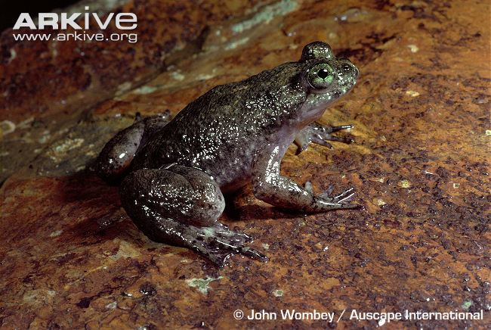
Extinct frogs
1,856 out of 5,743 species are in danger
122 species are extinct since 1980
Brooding frog
Australian frog
Swallowed her eggs and hatched her babies in her stomach
Now extinct, no known cause besides habitat loss
Photo from arkive.org
Click on the photo. Watch the three videos in this order (habitat, destruction of forest, and Brooding Frog in the tank and still of young in adults mouth).

Slide 8
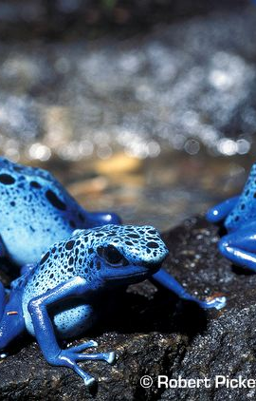
My Frog Book
Click the photo to the right to learn more about the Blue Poison Dart Frog.
Once you have watched the three videos and reviewed the Blue Poison Dart Frog webpage, on the last page of your my frog booklet write something you have learned about the Brooding Frog or the Blue Poison Dart Frog.
Don’t forget turn your booklet in by Wednesday June 17th
Photo from arkive.org

Slide 9
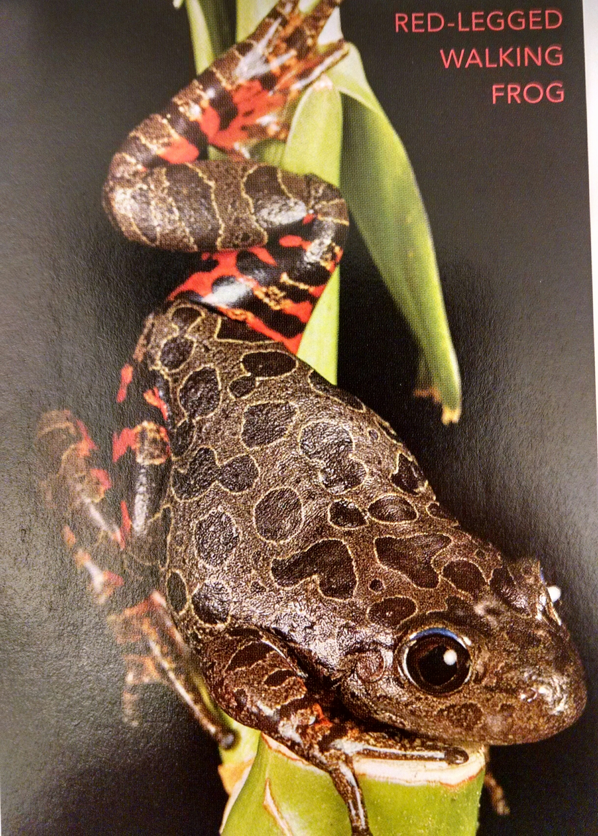
Red Legged Frog
From parts of California
-Reasons of threat:
Habitat loss, fungal disease, introduced bull frogs and fish
Killed by pesticides
Photo from The Frog Scientist book

Slide 10
Credits Slide
Comins, Andy. (2009). The Frog Scientist. New York, New York: Houghton Mifflin Harcourt Publishing Company.
Conant, R., & Collins, J. (1998). Reptiles and Amphibians: Eastern/ Central North America. New York, New York. Houghton Mifflin Publishing Company.
Long, Kim. (1998). Frogs: A wildlife handbook. Boulder, Colorado: Johnson Publishing Company.
National Aquarium (2015). Blue Poison Dart Frog. Retrieved on June 9th, 2015 from: http://www.aqua.org/explore/animals/blue- poison-dart-frog.
Simon, Hilda. (1975). Frogs and Toads of the world. New York: J.B. Lippincott Company.
Stone, Lynn. (1993). Frogs: Unusual Animals. Vero Beach, Florida: The Rourke Corporation.
Wildscreen Arkive (2000). Southern gastric-brooting frog. Retrieved on June 9th, from: http://www.arkive.org/southern-gastric-brooding-frog/rheobatrachus-silus/#video-00.html.

